Slide 1
Title: Exploring recommender systems for SCRATCH.
M.Sc. Dissertation
Roman Shaikh
M.Sc. Computer Science, Data Science 2018/19
Date 01/08/2019

Slide 2
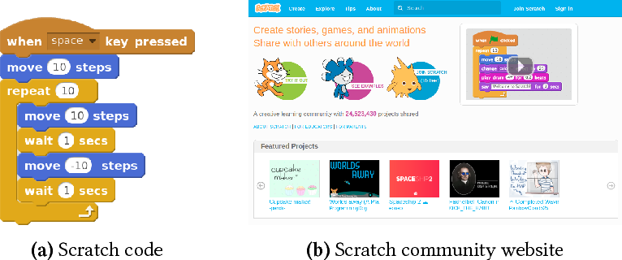
Overview
What is Scratch?
A block based programming language
Developed by the Lifelong Kindergarten group at the Massachusetts Institute of Technology
Drag and combine code blocks to make a range of programs, including animations, stories, musical instruments and games.
It’s a bit like the programming equivalent of LEGO!
Learn coding concepts and create interactive projects without needing to learn a text-based programming language.
Notes:
Scratch is a graphical programming language, developed by the Lifelong Kindergarten group at the Massachusetts Institute of Technology. Children can drag and combine code blocks to make a range of programs, including animations, stories, musical instruments and games. It’s a bit like the programming equivalent of LEGO!-
If children have a Scratch user account then projects can also be shared online with the Scratch community, giving children a real audience for their creations.
Scratch is used in many schools as part of the curriculum. Scratch is free to use and children can use it at home as well as during Code Club.

Slide 3
Scratch Community.
A huge online community of people sharing programs made in Scratch and associated resources - tutorial videos on YouTube, lesson plans, program ideas.
On Scratch, members have the capability to share their projects and get feedback.
Projects can be uploaded directly from the development environment to the Scratch website and any member of the community can download the full source code to study or to remix into new projects
Members can also create project studios, comment, tag, favorite, and "love" others' projects, follow other members to see their projects and activity, and share ideas.
Projects range from games to animations to practical tools. Additionally, to encourage creation and sharing amongst users, the website frequently establishes "Scratch Design Studio" challenge

Slide 4
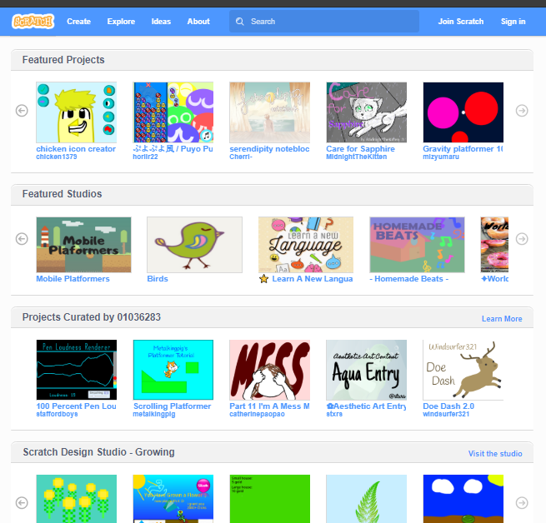
Research Question
The problem of discovery.
Current ways of discovering content.
Featured Projects, Featured Studios, Projects Curated by, Growing etc.
Young users find it difficult to get discovered
amongst the peer group.
No personalised recommendations.
Engaging users with same interest.
Notes:
You can just go and start building the project.

Slide 5
Research Question
Proposing recommender system as the solution.
I propose a recommender system for scratch that would present recommendations to users about the projects to follow.
Based on previous activity of the user.
Look at what kind of projects the user likes
What the user is developing
Who the user is interacting with.

Slide 6
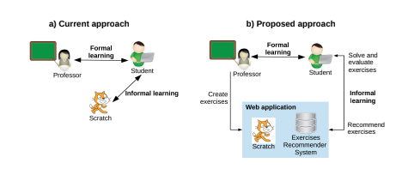
Recommender system
State of Art in the field.
Studies showing importance of recommendation in an e-learning environment.
CARAMBA a scratch extension for recommending exercises.
State University of Milagro proposes a scratch recommendation system involving exercise for

Slide 7
Recommender system
Established standard
Content based Filtering
Information
Knowledge based
Collaborative Filtering
User-user
Item-Item
Dimensionality reduction
Others
Critique/Interview based recommendation
Hybrid techniques

Slide 8
Personalised recommendation
Design and Implementation
Recommender system is an information filtering technique, which provides user with information, he/she may be interested in.
Recommendation
R is a list of items such that Ir Iwhich contains the items the user will like the most. It is to be noted that the R should not contain items that the user is already associated with i.e. for example the projects that the user already has on his page.
Predictions
is a number Pa,j representing the predicted likeliness of the item for the user ua. The predicted value is same as that of the normalised scale of the user ratings.

Slide 9
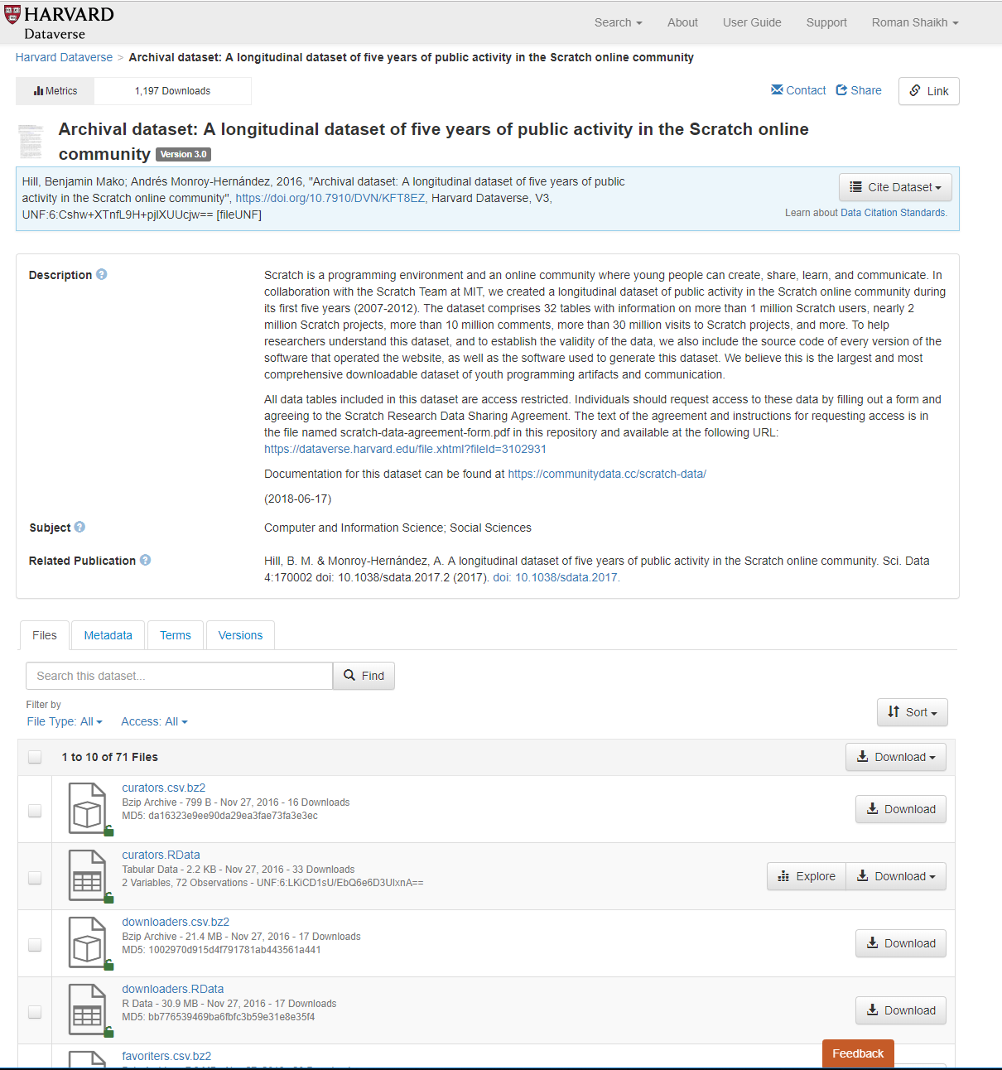
The Dataset
https://dataverse.harvard.edu/
The Scratch Online Community has made the dataset for scratch platform publicly on Harvard dataverse
The dataset has the data for the first five years of the data from Scratch (approximately from 2007-2012).
The data was collected from the MySQL database from the Scratch website.
It is divided into 3 main categories Core Datasets, Text and Code Datasets and a Project Analytics Datasets

Slide 10
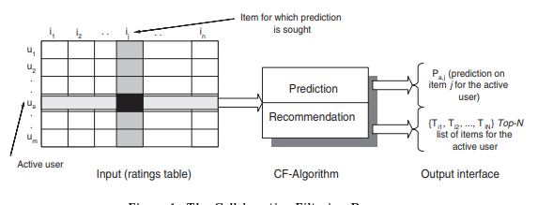
Collaborative Filtering Process
Collaborative Filtering Process
Notes:
The goal of a collaborative ltering algorithm is to suggest new items or to predict the utility of a certain item for a particular user based on the user's previous likings and the opinions of other like-minded users. In a typical CF scenario, there is a list of m users U = fu1 ; u2 ;::: ;umg and a list of n items I = fi1; i2 ;::: ;ing. Each user ui has a list of items Iui , which the user has expressed his/her opinions about. Opinions can be explicitly given by the user as a rating score, generally within a certain numerical scale, or can be implicitly derived from purchase records, by analyzing timing logs, by mining web hyperlinks and so on [28, 16]. Note that Iui I and it is possible for Iui to be a nul l-set. There exists a distinguished user ua 2 U called the active user for whom the task of a collaborative ltering algorithm is to nd an item likeliness that can be of two forms.

Slide 11
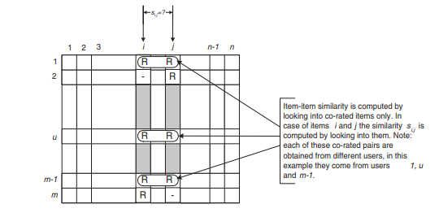
Isolation of the co-rated items and similarity computation

Slide 12
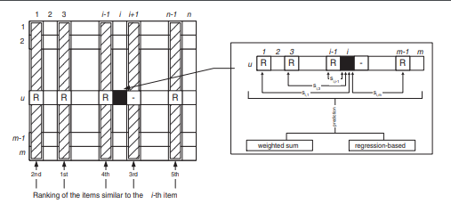
Item-based collaborative filtering algorithm

Slide 13

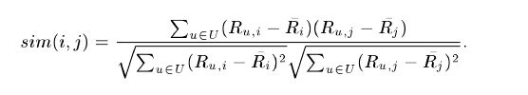

Personalised recommendation
Design and Implementation
Recommender system is an information filtering technique, which provides user with information, he/she may be interested in.
Recommendation
Cosine based similarity
Correlation based similarity
Adjusted-cosine based closeness

Slide 14


Personalised recommendation
Design and Implementation
Recommender system is an information filtering technique, which provides user with information, he/she may be interested in.
Predictions
Weighted sum method
User rating attributes from the datasets:
Favourites - Boolean if a user has favorited the project
Likes - Boolean if the user has liked/loved the project ( i.e. pressed the heart on the project page)
Views - the number of times the project has been viewed.
Remixes - Boolean if the project has been remixed by the user.

Slide 15
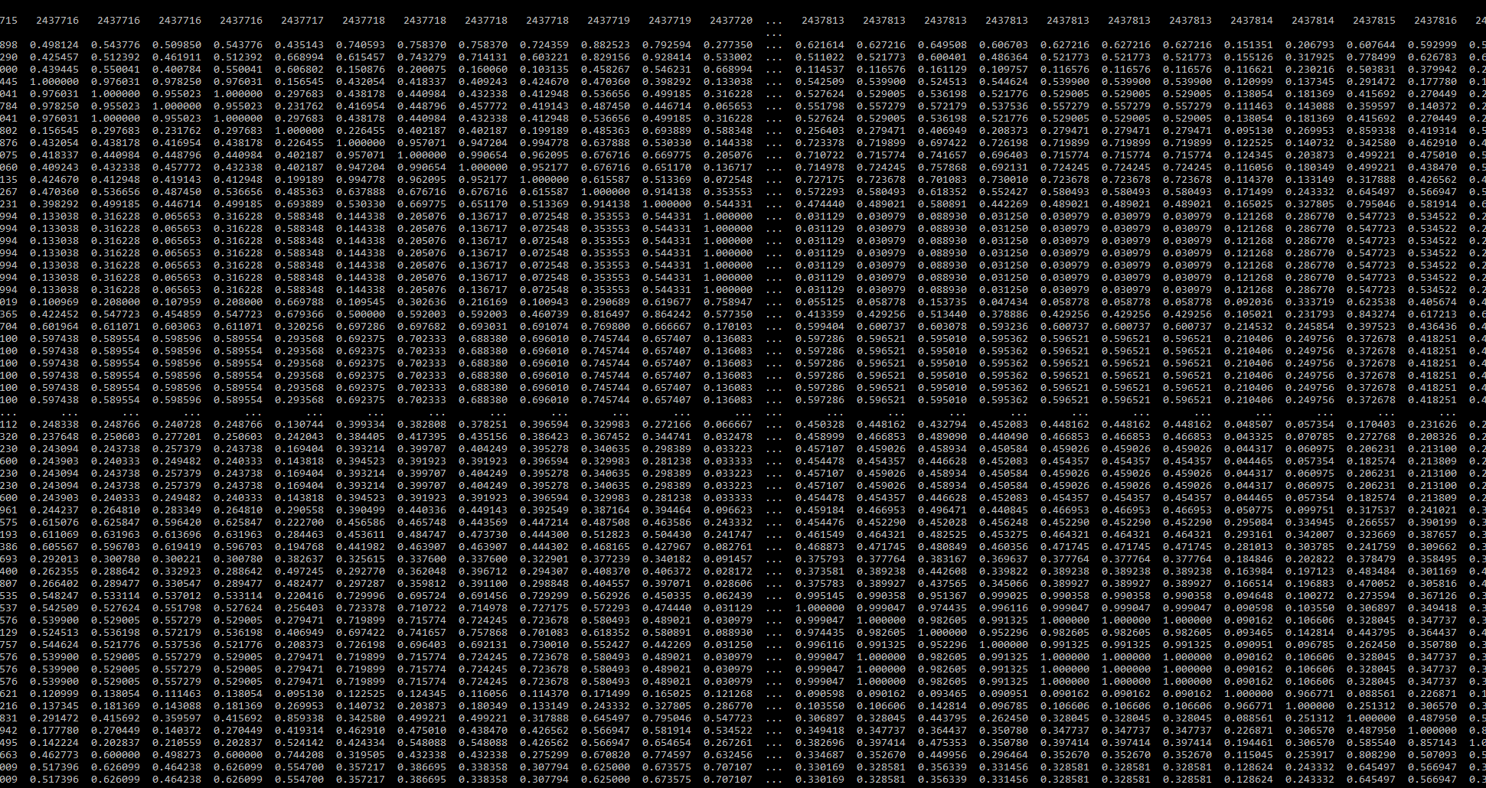
Results
Correlation matrix

Slide 16
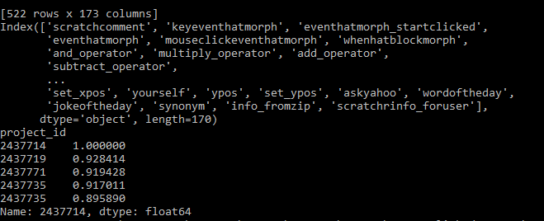
Results
Predictions

Slide 17
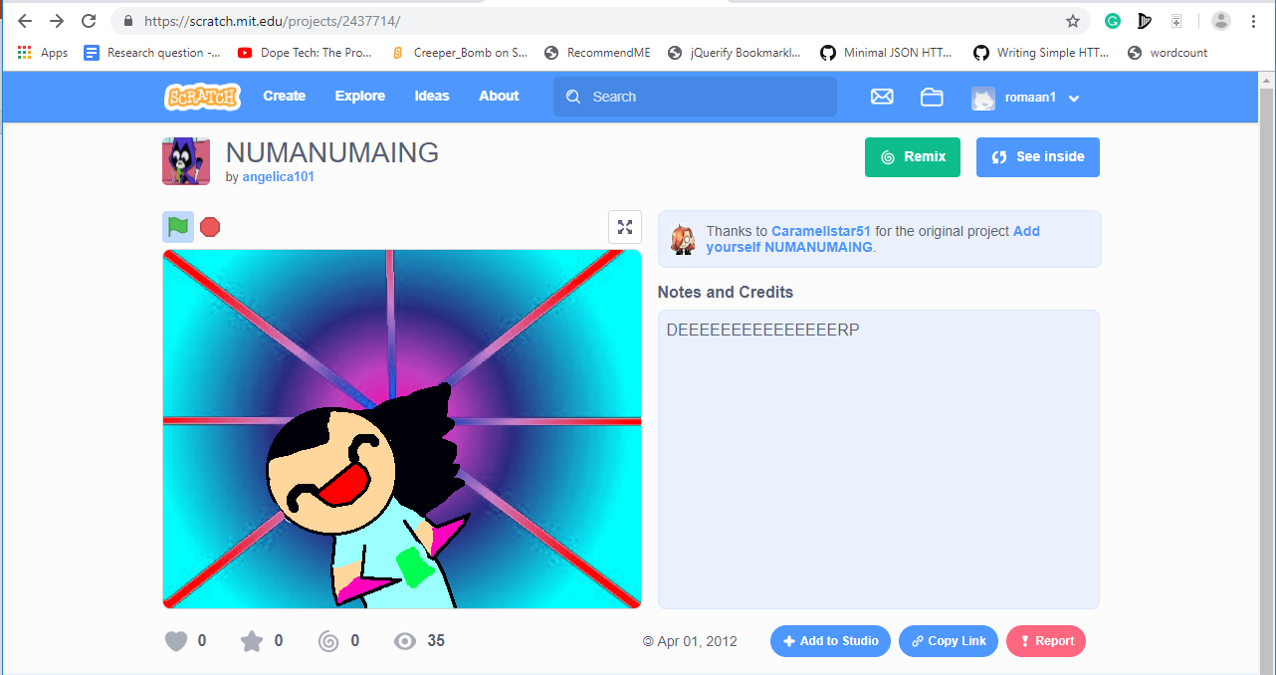
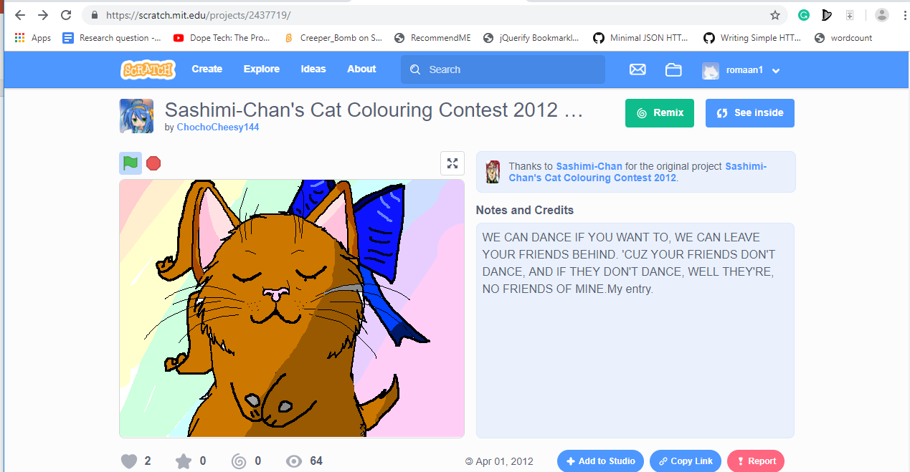
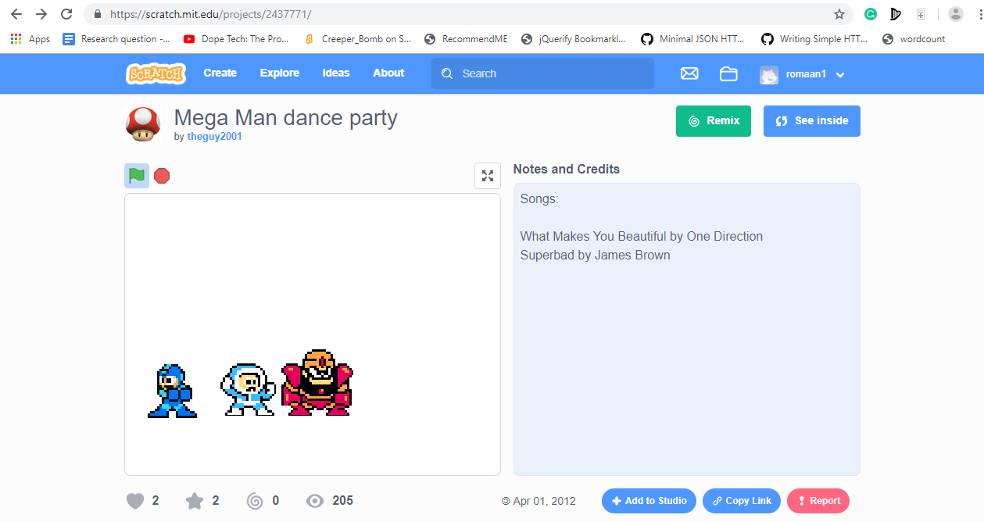
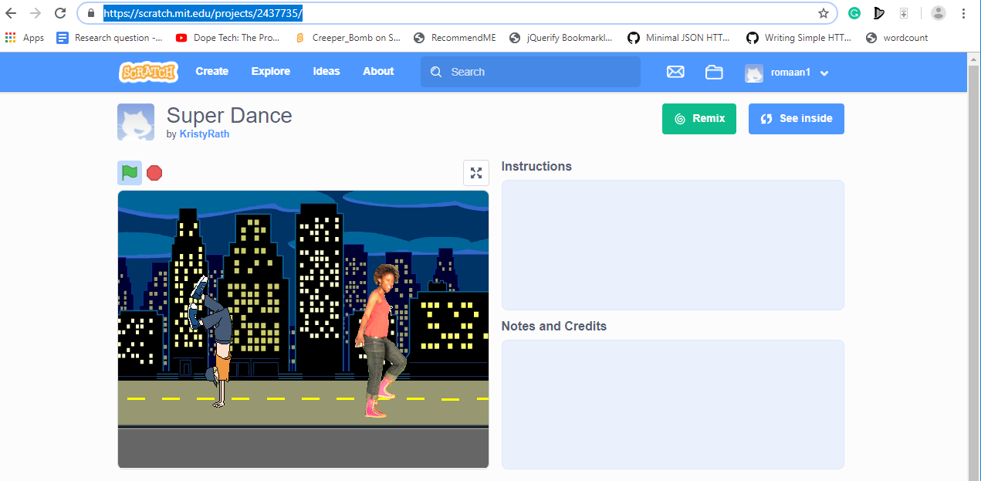
Results
Comparison
https://scratch.mit.edu/projects/2437714/
https://scratch.mit.edu/projects/2437719/
https://scratch.mit.edu/projects/2437771/
https://scratch.mit.edu/projects/2437735/

Slide 18

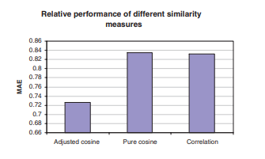
Evaluation methods Evaluation methods
MAE - Mean Absolute Error
Statistical accuracy metrics evaluate the accuracy of a system by comparing the numerical recommendation scores against the actual user ratings for the user-item pairs in the test dataset.
The lower the MAE, the more accurately the recommendation engine predicts user ratings.
Root Mean Squared Error (RMSE), and Correlation are also used as statistical accuracy metric.

Slide 19
Future Work
Accuracy of prediction – Conduct tests
Computational Performance – Compare performance on online data
Text analytics for more accurate results -Text mining on comments and code to find context and interest.
TFIDF on tag data to identify context / content-based filtering

Slide 20
Thank You

